Slide 1
Analysis Tools Chapter 4

Slide 2

Topics
Algorithms Analysis
Seven Fundamental Functions
Big-Oh
Justification Techniques

Slide 3
Analysis of Algorithms
Input
Algorithm
Output
An algorithm is a step-by-step procedure for
solving a problem in a finite amount of time

Slide 4
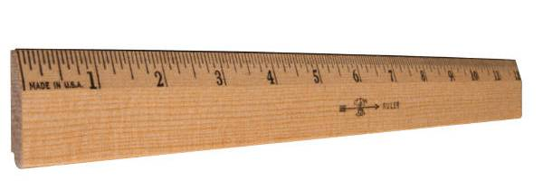
Characterizing Algorithms
Investigating the run times of algorithms and data structure operations
Focus will be on the relationship between running time of an algorithms and the size of the input

Slide 5

Can We Write Better Algorithms?
“Better.”
―Michelangelo, when asked how he would have made his statue of Moses if he had to do it over again
Goal is to write algorithms that run in log n, linear or n-log-n time

Slide 6

Goal of Algorithm Development
or

Slide 7
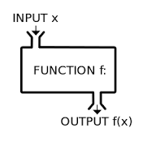
Seven Functions
These functions are often used in algorithm analysis
Constant ≈ 1
Logarithmic ≈ log n
Linear ≈ n
n-log-n ≈ n log n
Quadratic ≈ n²
Cubic ≈ n³
Exponential ≈ 2^{n}

Slide 8
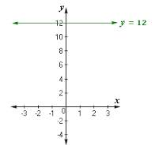
Constant Function
f (n) = c
Typically f (n) = 1 is used during algorithm analysis
A constant function is used to characterize the number of steps needed to do basic operations
Adding two numbers
Assigning a value to a variable
Comparing two numbers
Not dependent on the size of the input

Slide 9
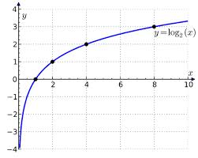
Logarithm Function
f (n) = log_{b}n for some constant b
The function is defined as follows
x= log_{b}n if and only if b^{x}=n (log_{n}1=0)
2 is the most common base used during analyzing algorithms
Used in this class

Slide 10
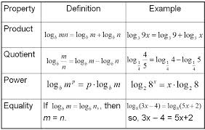
Basic Properties of Logarithms
log_{b}(xy) = log_{b}x + log_{b}y
log_{b} (x/y) = log_{b}x - log_{b}y
log_{b}xª = alog_{b}x
log_{b}a = log_{d}a/log_{d}b
b ^{log}_{d}ª = a ^{log}_{d}^{b}
log₂n= log n/ log 2 (converts base 10 to base 2)

Slide 11

Examples Using Logarithms Properties
log₂(2n) = log₂2 + log₂n = 1 + log₂n
log₂ (n/2) = log₂n – log₂2 = log₂n – 1
log₂n³ = 3log₂n
log₂2^{n} = n*1 = n
log₄n = log₂n/log₂4= (log₂n)/2
2 ^{log}₂^{n} = n ^{log}₂²⁼ n

Slide 12
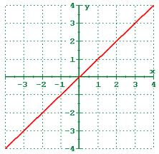
Linear Function
f (n) = n
Function arises when the same basic operation is done for n elements
For example
Comparing a constant c to each element of an array of size n requires n comparisons
Reading n objects requires n operations

Slide 13
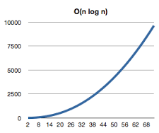
n-log-n Function
f (n) = n log₂n
This function
Grows a little faster than the linear function, f (n) = n
Grows much slower than the quadratic n², f (n) = n²
If one can improve the running time of solving some problem from a quadratic to n-log-n, one will have an algorithm that runs much faster

Slide 14
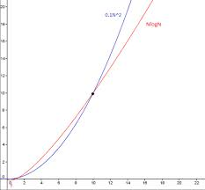
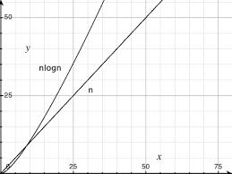
Comparison of Functions
n² vs nlogn
n vs nlogn

Slide 15
Notation
Summation
Polynomial
1 + 2 + 3+ … + (n-2) + (n-1) + n = n(n+1)/2
Summation of the first n numbers

Slide 16
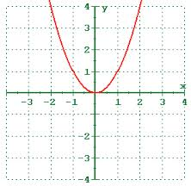
Quadratic Function
f (n) = n²
This function is used in analysis since many algorithms contain nested loops
The inner loop performs n operations while the outer loop performs n operations (n * n = n²)

Slide 17
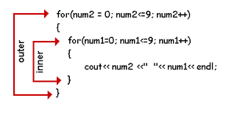
Nested Loops and the Quadratic Function (1)
The quadratic function also is used in the context of nested loops where the first iteration uses one operation, the second uses two operations, the third uses three operations, and so on (for the inner loop)
The number of operations performed is
1 + 2 + 3+ … + (n-2) + (n-1) + n = n(n+1)/2=(n²+n)/2 =n²/2+n/2
Note: n² > (n²+n)/2

Slide 18

Nested Loops and the Quadratic Function (2)
An algorithm characterized where the first iteration uses one operation, the second use two operations, the third uses three operations and so on, is only slightly better than an algorithm that uses n operations each time through the loop (n²)

Slide 19
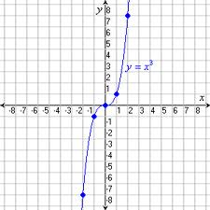
Cubic Function
f (n) = n³
This function is used often used in algorithm analysis

Slide 20
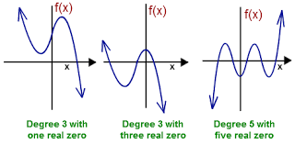
Polynomials
f (n) = a_{o} +a₁n +a₂n²+… a_{d}n^{d}
This function has degree d
Running times that are polynomials with degree d are generally better than polynomials with a larger degree
Note: the constant, linear, quadratic, and cubic functions are polynomials

Slide 21

Exponential Function
f (n) = b^{n}
Most common based used in algorithm analysis is 2
If a loops starts by performing one operation and then doubles the number of operations performed within each iteration
The number of operations performed in the n^{th} iteration is 2^{n}

Slide 22
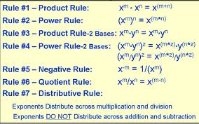
Basic Properties of Exponentials

Slide 23
Geometric Sums
Suppose there is a loop where each iteration takes a multiplicative factor longer than the previous one
Summations are called geometric summations because each term is geometrically larger than the previous term
For example
1+2+4+8+…+2^{n-1} =2^{n}-1 is the largest integer that can be represented in n bits
The largest 32 bit unsigned integer is 2³² -1

Slide 24
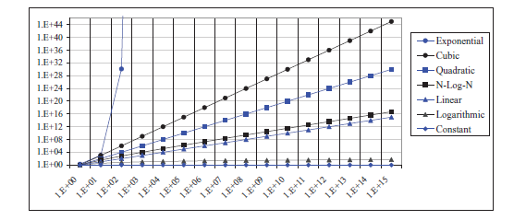
Comparison of Functions

Slide 25
Ceiling and Floor Functions
The running time of an algorithm is generally expressed by means of an integer
The largest integer less than or equal to x (floor function)
The smallest integer greater than or equal to x (ceiling function)

Slide 26

Data Structure Definition
A data structure is a systematic way of organizing and accessing data

Slide 27
Running Time
Most algorithms transform input objects into output objects
The running time of an algorithm typically grows with the input size
Average case time is often difficult to determine
We focus on the worst case running time
Easier to analyze
Crucial to applications such as games, finance and robotics

Slide 28

Growth Rate of Running Time
Changing the hardware/software environment
Affects running time by a constant factor
It but does not alter the growth rate
Running time is a natural measure of “goodness” since time is a precious resource

Slide 29
Experimental Studies
One can write a program implementing an algorithm
Run the program with inputs of varying size and composition
Use methods like time(), clock(), or currentTimeMillis() to get an accurate measure of the actual running time
Plot the results

Slide 30

Executing Time Question
Suppose two algorithms perform the same task such as search (linear search vs. binary search) and sorting (selection sort vs. insertion sort)
Which one is better?
One possible approach to answer this question is to implement these algorithms and run the programs to get execution time
But there are two problems with this approach…..

Slide 31

Problems Measuring Execution Time
First, there are many tasks running concurrently on a computer
The execution time of a particular program is dependent on the system load
Second, the execution time is dependent on specific input
Consider linear search and binary search
If an element to be searched happens to be the first in the list, linear search will find the element quicker than binary search

Slide 32


Limitations of Experiments
It is necessary to implement the algorithm, which may be difficult
Results may not be indicative of the running time on other inputs not included in the experiment
In order to compare two algorithms, the same hardware and software environments must be used

Slide 33

Theoretical Analysis
Uses a high-level description of the algorithm instead of an implementation
Characterizes running time as a function of the input size, n
Takes into account all possible inputs
Allows one to evaluate the speed of an algorithm independent of the hardware/software environment

Slide 34

Growth Rate (1)
It is very difficult to compare algorithms by measuring their execution time
To overcome these problems, a theoretical approach has been developed to analyze algorithms independent of computers and specific input
This approach approximates the effect of a change on the size of the input

Slide 35
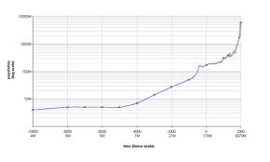
Growth Rate (2)
In this way, one can see how fast an algorithm’s execution time increases as the input size increases, so one can compare two algorithms by examining their growth rates

Slide 36
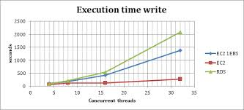
Execution Time (1)
The linear search algorithm compares the key with the elements in the array sequentially until the key is found or the array is exhausted
If the key is not in the array, it requires n comparisons for an array of size n
If the key is in the array, it requires n/2 comparisons on average

Slide 37

Execution Time (2)
The algorithm’s execution time is proportional to the size of the array
If one doubles the size of the array, one will expect the number of comparisons to double
The algorithm grows at a linear rate
The growth rate has an order of magnitude of n

Slide 38
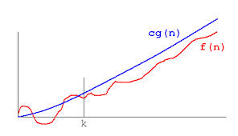
Big Oh Notation
Computer analysts use Big Oh (order of magnitude) to measure the complexity of an algorithm
Denoted by O(n)
Pronounced as “order of n”

Slide 39

Best, Worst, and Average Cases
For the same input size, an algorithm’s execution time may vary, depending on the input
An input that results in the shortest execution time is called the best-case input and an input that results in the longest execution time is called the worst-case input
Best-case and worst-case are not always representative, but worst-case analysis is very useful

Slide 40

Worst, and Average Cases
One can show that the algorithm will never be slower than the worst-case
An average-case analysis attempts to determine the average amount of time among all possible input of the same size

Slide 41
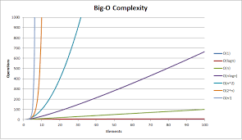
Big-Oh Inequality
Let f(n) and g(n) be non-negative functions
Then f(n) is O(g(n)) if there are positive constant c and n₀ ≥ 1 such that f(n) ≤ cg(n) for n ≥ n₀
This definition is referred to as the big-Oh notation or f(n) is big-Oh of g(n) or f(n) is order of g(n)

Slide 42
Big-Oh and Growth Rate
The big-Oh notation gives an upper bound on the growth rate of a function
The statement “f(n) is O(g(n))” means that the growth rate of f(n) is no more than the growth rate of g(n)
 | f(n) is O(g(n)) | g(n) is O(f(n))
g(n) grows more | Yes | No
f(n) grows more | No | Yes

Slide 43
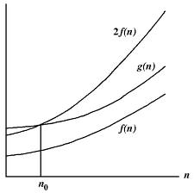
Ignoring Multiplicative Constants
The linear search algorithm requires n comparisons in the worst-case and n/2 comparisons in the average-case
Using the Big Oh notation, both cases require O(n) time
The multiplicative constant (1/2) is normally omitted
Algorithm analysis is focused on growth rate
The multiplicative constants have little impact on growth rates
The growth rates n/2 and 100n are equivalent to n
O(n) = O(n/2) = O(100n)

Slide 44
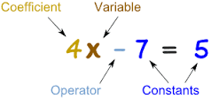
Constant Factors
The growth rate is not affected by
constant factors or
lower-order terms
Examples
10²n + 10⁵ is a linear function
10⁵n² + 10⁸n is a quadratic function

Slide 45
Ignoring Non-Dominating Terms
Consider the algorithm for finding the maximum number in an array of n elements
If n is 2, it takes one comparison to find the maximum number
If n is 3, it takes two comparisons to find the maximum number
In general, it takes n-1 times of comparisons to find maximum number in a list of n elements
Remember: If the input size is small, there is no significance to estimate an algorithm’s efficiency

Slide 46

Big-Oh Rules
Use the smallest possible class of functions
Say “2n is O(n)” instead of “2n is O(2n)”
Use the simplest expression of the class
Say “3n + 5 is O(n)” instead of “3n + 5 is O(3n)”

Slide 47

Big-Oh Example (1)
8n - 2 is O(n)
Justification
Find c and n₀ such that 8n-2 ≤ cn
Pick c = 8 and n₀ = 1 (there are an infinite number of solutions)
8n - 2 ≤ 8n

Slide 48
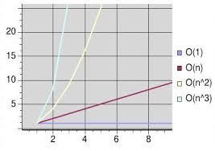
Big-Oh Example (2)
2n +10 is O(n)
Justification
2n + 10 ≤ cn
2n-cn ≤ -10
n(2-c) ≤ -10
n(c-2) ≥ 10
n ≥ 10/(c-2)
Let c=3 and n₀=10

Slide 49
Big-Oh Examples (3)
5n⁴+3n³+2n²+4n+1 is O(n⁴)
Justification
5n⁴+3n³+2n²+4n+1 ≤ (5+3+2+4+1) n⁴ = cn⁴ where c=15 and n₀=1
5n²+3log(n)+2n+5 is O(n²)
Justification
5n²+3log(n)+2n+5 ≤ (5+3+2+5) n²=cn² where c=15 and n ≥ n₀=2

Slide 50
Big-Oh Examples (4)
20n³+10nlog(n)+5 is O(n³)
Justification
20n³+10nlog(n)+5 ≤ 35 n³ = cn³ where c=35 and n ≥ n₀=2
3log(n)+2 is O(log n)
Justification
3log(n)+2 ≤ 5 log(n) where c=5 and n ≥ 2

Slide 51
Big-Oh Examples (5)
2^{n+1} is O(2^{n})
Justification
2^{n+1} = 2^{n} *2¹ =2* 2^{n} ≤ 2* 2^{n} where c=2 and n₀=1
2n+100log(n) is O(n)
Justification
2n+100log(n) ≤ 102n where c=102 and n ≥ n₀=2
3 log n + 5 is O(log n)
Justification
3 log n + 5 ≤ 8 log n where c = 8 and n₀ = 2

Slide 52
Big-Oh Example (6)
n² is not O(n)
Justification
n² ≤ cn
n ≤ c
The above inequality cannot be satisfied since c must be a constant

Slide 53
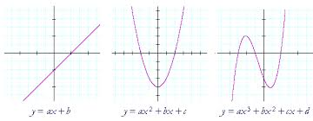
Proposition 4.9
f(n)= a₀+a₁n +…a_{d}n^{d} and a_{i}>0
Then f(n) is O(n^{d})
Justification
a₀+a₁n +…a_{d}n^{d} ≤ (a₀+a₁+a₂+…+a_{d}) n^{d}
f(n) is O(n^{d}) where c= a₀+a₁+a₂+…+a_{d} and n₀=1

Slide 54

Big-Oh Rules (Summarized)
If is f(n) a polynomial of degree d, then f(n) is O(n^{d}), i.e.,
Drop lower-order terms
Drop constant factors
Use the smallest possible class of functions
Say “2n is O(n)” instead of “2n is O(n²)”
Use the simplest expression of the class
Say “3n + 5 is O(n)” instead of “3n + 5 is O(3n)”

Slide 55

Increasing Common Growth Functions
Assume base 2 for all logs
Constant time
Logarithmic time
Linear time
Log-linear time
Quadratic time
Cubic time
Exponential time

Slide 56

Relatives of Big-Oh(1)
big-Omega
f(n) is Ω(g(n)) if there is a constant c > 0
and an integer constant n₀ ≥ 1 such that
f(n) ≥ cg(n) for n ≥ n₀
3nlog(n) + 2n is Ω(nlog(n))
Justification
3nlog(n)+2n ≥ 3nlog(n) where c = 3 and n₀ = 2
5n² is Ω(n²)
Justification
5n² ≥ 5n² where c = 5 and n₀ = 1

Slide 57
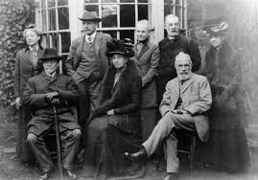

Another Relative of Big-Oh
big-Theta
Two functions that grow at the same rate up to constant factors
f(n) is Θ(g(n)) if there are constants c’ > 0 and c’’ > 0 and an integer constant n₀ ≥ 1 such that
c’g(n) ≤ f(n) ≤ c’’g(n) for n ≥ n₀
3nlog(n) +4n+5log(n) is Θ(nlog(n)
Justification
3nlog(n) ≤ 3nlog(n) +4n+5log(n) ≤ (3+4+5)nlog (n) = 12nlog(n) for n ≥2
c’ = 3, c’’ = 12, n₀ = 2

Slide 58
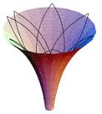
Asymptotic Notation
Big-Oh
f(n) is O(g(n)) if f(n) is asymptotically less than or equal to g(n)
big-Omega
f(n) is Ω(g(n)) if f(n) is asymptotically greater than or equal to g(n)
big-Theta
f(n) is Θ(g(n)) if f(n) is asymptotically equal to g(n)

Slide 59
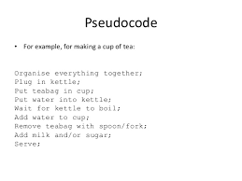
Pseudo-code
High-level description of an algorithm
More structured than English prose
Less detailed than a program
Preferred notation for describing algorithms
Hides program design issues

Slide 60
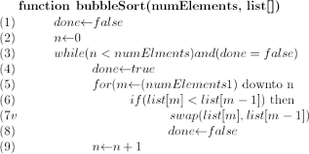
Primitive Operations
Basic computations performed by an algorithm
Identifiable in pseudo-code
Largely independent of the programming language
Exact definition not important
Example primitive operations:
Evaluating an expression
Assigning a value to a variable
Indexing into an array
Calling a method
Returning from a method

Slide 61

Counting Primitive Operations
Primitive operations correspond to low level instructions
Assumption
Execution time is the same constant for all primitives
Primitive operations are counted to measure execution time

Slide 62
Pseudo-code Details
Control flow
if … then … [else …]
while … do …
repeat … until …
for … do …
Indentation replaces braces
Method declaration
Algorithm method (arg [, arg…])
Input …
Output …
Method call
var.method (arg [, arg…])
Return value
return expression
Expressions
Assignment (like = in C++)
Equality testing (like == in C++)
n² Superscripts and other mathematical formatting allowed

Slide 63
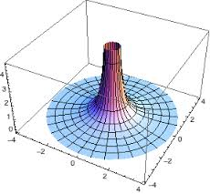
Asymptotic Algorithm Analysis
The asymptotic analysis of an algorithm determines the running time in big-Oh notation
To perform the asymptotic analysis
We find the worst-case number of primitive operations executed as a function of the input size
We express this function with big-Oh notation
Since constant factors and lower-order terms are eventually dropped anyhow
One disregards them when counting primitive operations

Slide 64

Computing Prefix Averages
One can illustrate asymptotic analysis with two different algorithms for prefix averages
Computing the array A of prefix averages of another array X has applications to financial analysis

Slide 65
Prefix Averages (Quadratic)
The following algorithm computes prefix average in quadratic time (A[i] is the average of X[0], X[1], .. X[i])
Algorithm prefixAverages1(X):
Input: An n-element array X of numbers
Output: An n-element array A of numbers such that A[i] is the average of X[0], X[1], .. X[i])
#Operations
A ← new array of n numbers n
for i ← 0 to n − 1 do n
a ← 0 n
for j ← 0 to i do 1 + 2 + …+ (n − 1) = n(n+1)/2
a ← a + X[j] 1 + 2 + …+ (n − 1) = n(n+1)/2
A[i] ← a / (i + 1) n
return A 1
See next slide for the corresponding analysis

Slide 66
Big-Oh Analysis
Initializing and returning array A can be done with a constant number of primitive operations
O(n) time
The two nested loops are controlled by i and j respectively
The body of the outer loop is executed n times (i = 0, 1, … n – 1)
The statements a=0 and A[i] ← a / (i + 1) are executed n times (O(n) time)
The body of the inner loop (controlled by j) is executed i + 1 times depending on the value of the outer loop i
Executed 1 + 2 + 3 + … + n = n(n+1)/2 times
The running time is 4n+1+n²+n² is O(n²)

Slide 67
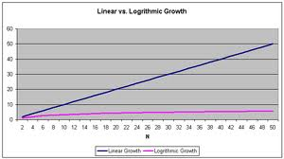
Linear-Time Algorithm
A[i–1] = X[0] + X[1] + ... X[i - 1]) / i
A[i] = (X[0] + X[1] + ... X[i - 1] + X[i]) / (i + 1)
Keeps track of the current prefix sum
Doesn’t recalculate the sum starting at X[0]

Slide 68
Prefix Averages (Linear)
The following algorithm computes prefix averages in linear time by keeping a running sum
Algorithm prefixAverages2(X):
Input: An n-element array X of numbers
Output: An n-element array A of numbers such that A[i] is the average of X[0], X[1], .. X[i])
#operations
A ← new array of n integers n
s ← 0 1
for i ← 0 to n − 1 do n
s ← s + X[i] n
A[i] ← s / (i + 1) n
return A 1
See next slide for the corresponding analysis

Slide 69
Big-Oh Analysis
Initializing and returning array A can be done with a constant number of primitive operations
O(n) time
Initializing variable s takes O(1) time
O(n) time
There is a single loop which is controlled by counter i
The body of the loop is executed n times (i = 0, 1, … n – 1)
The statements s ← s + X[i] and A[i] ← s / (i + 1) are executed n times (O(n) time)
Algorithm prefixAverages2 runs in O(n) time

Slide 70
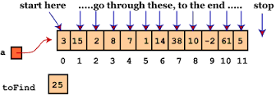
Linear Search
Consider the set {0,1,2,3,4,5}
One would start from the index of the set, 0, and then look at each next value until it finds the value a particular value
It would take four comparisons looking for 3
It would take six comparison looking for 6
From this one concludes that the algorithm will make a number of comparisons equal to the input size, n, and thus is O(n)

Slide 71
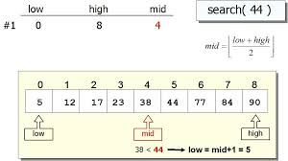
Binary Search (1)
For binary search to work, the elements in the array must already be ordered
Without loss of generality, assume that the array is in ascending order
e.g., 2 4 7 10 11 45 50 59 60 66 69 70 79
The binary search first compares the key with the element in the middle of the array

Slide 72
Binary Search (2)
Consider the following three cases:
If the key is less than the middle element, one only needs to search the key in the first half of the array
If the key is equal to the middle element, the search ends with a match
If the key is greater than the middle element, one only needs to search the key in the second half of the array

Slide 73
Binary Search
Key
List
8
1 | 2 | 3 | 4 | 6 | 7 | 8 | 9
8
1 | 2 | 3 | 4 | 6 | 7 | 8 | 9
8
1 | 2 | 3 | 4 | 6 | 7 | 8 | 9

Slide 74
Another Binary Search

Slide 75
Still Another Binary Search

Slide 76
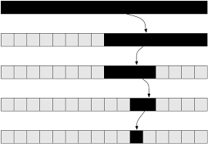
Binary Search Results
The binarySearch method returns the index of the element in the list that matches the search key if it is contained in the list
Otherwise, it returns negative 1

Slide 77
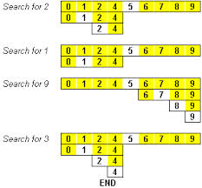
Binary Search Algorithm
class BinarySearch {
/** Use binary search to find the key in the list */
static int binarySearch(int[ ] list, int key) {
int low = 0;
int high = list.length - 1;
while (high >= low) { // the number of times through the loop determines Big Oh
int mid = (low + high) / 2;
if (key < list[mid])
high = mid - 1;
else if (key == list[mid])
return mid;
else
low = mid + 1;
}
return -low - 1; // Now high < low
}
}

Slide 78
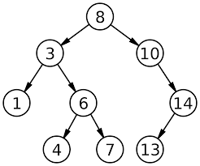
Analyzing the Binary Search
If the original number of items is n then after the first iteration there will be at most n/2 items remaining, then at most n/4 items, at most n/8 items, and so on
In the worst case, when the value is not in the list, the algorithm must continue iterating until the span has been made empty; this will have taken at most log₂(n) + 1 iterations
For example, if N=16, there are at most 5 iterations needed (log₂(16)+1=5 )

Slide 79
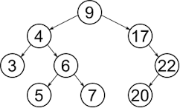
Linear Search vs. Binary Search
When compared to linear search whose worst-case behavior is N iterations, the binary search is substantially faster as N grows large
For example, to search a list of one million items takes as many as one million iterations with linear search, but never more than twenty (2²⁰=1,048,576) iterations with binary search
However, a binary search can only be performed if the list is in sorted order

Slide 80
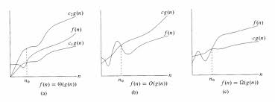
Determining Big-Oh
Repetition
Sequence

Slide 81

Repetition: Simple Loops
for (i = 1; i <= n; i++) {
k = k + 5;
}
executed
n times
constant time
O(n)
Ignore multiplicative constants (e.g., “c”).
c is the time to execute a simple statement

Slide 82
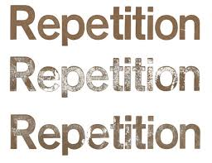
Repetition: Nested Loops (1)
for (i = 1; i <= n; i++) {
for (j = 1; j <= n; j++) {
k = k + i + j;
}
}
executed
n times
inner loop
executed
n times
constant time
O(n²)
Ignore multiplicative constants (e.g., “c”).

Slide 83
Repetition: Nested Loops (2)
for (i = 1; i <= n; i++) {
for (j = 1; j <= i; j++) {
k = k + i + j;
}
}
executed
n times
inner loop
executed
i times
constant time
c + 2c + 3c + 4c + … + nc = cn(n+1)/2 = (c/2)n² + (c/2)n = O(n²)
Ignore non-dominating terms
Ignore multiplicative constants

Slide 84
Repetition: Nested Loops (3)
for (i = 1; i <= n; i++) {
for (j = 1; j <= 20; j++) {
k = k + i + j;
}
}
executed
n times
inner loop
executed
20 times
constant time
20 * c * n = O(n)
Ignore multiplicative constants (e.g., 20*c)

Slide 85
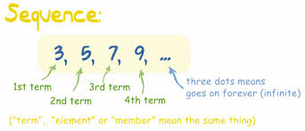
Sequence
for (j = 1; j <= 10; j++) {
k = k + 4;
}
executed
10 times
for (i = 1; i <= n; i++) {
for (j = 1; j <= 20; j++) {
k = k + i + j;
}
}
executed
n times
inner loop
executed
20 times
c *10 + 20 * c * n = O(n)

Slide 86

Computing Powers
The power function, p(x,n)=x^{n}, can be defined recursively:
This leads to an power function that runs in O(n) time (for we make n recursive calls)
x^{n} = x^{n-1} * x (n times)
This can be improved

Slide 87
Recursive Squaring
We can derive a more efficient linearly recursive algorithm by using repeated squaring:
For example,
2⁴ = 2^{(4/2)2} = (2^{4/2})² = (2²)² = 4² = 16
2⁵ = 2^{1+(4/2)2} = 2(2^{4/2})² = 2(2²)² = 2(4²) = 32
2⁶ = 2^{(6/ 2)2} = (2^{6/2})² = (2³)² = 8² = 64
2⁷ = 2^{1+(6/2)2} = 2(2^{6/2})² = 2(2³)² = 2(8²) = 128

Slide 88
Recursive Squaring Method
Algorithm Power(x, n):
Input: A number x and integer n ≥ 0
Output: The value x^{n}
if n = 0 then
return 1
if n is odd then
y = Power(x, (n - 1)/ 2)
return x · y ·y
else
y = Power(x, n/ 2)
return y · y
(see next page for analysis)

Slide 89
Analysis
Algorithm Power(x, n):
Input: A number x and integer n = 0
Output: The value x^{n}
if n = 0 then
return 1
if n is odd then
y = Power(x, (n - 1)/ 2)
return x · y · y
else
y = Power(x, n/ 2)
return y · y
Each time one makes a recursive call we half the value of n; hence, we make log n recursive calls
This method runs in O(log n) time
It is important that we use a variable twice here rather than calling the method twice

Slide 90
Find Maximum Element of an Array using Pseudo-code
Algorithm arrayMax(A, n)
Input array A of n integers
currentMax ← A[0]
for i ← 1 to n − 1 do
if A[i] > currentMax then
currentMax ← A[i]
return currentMax
Output maximum element of A
What is the Big O representation of this algorithm?

Slide 91

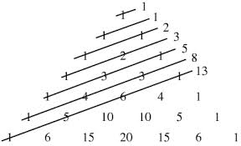
Fibonacci Numbers
0, 1, 1, 2, 3, 5, 8, 13, 21, 34, 55, 89, 144, 233, 377, 610, 987,…
The next number in the sequence is the sum of the previous two numbers

Slide 92
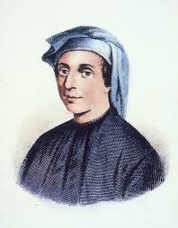
Fibonacci Numbers Recursion
// The method for finding the Fibonacci number
public static long fib(long index) {
if (index == 0) // Base case
return 0;
else if (index == 1) // base case
return 1;
else // reduction and recursive calls
return fib(index - 1) + fib(index - 2);
}
See example fib1

Slide 93
Fibonacci Numbers Recursion
If a loops starts by performing one operation and then doubles the number of operations performed within each iteration
The number of operations performed in the n^{th} iteration is 2^{n}
This recursive Fibonacci method takes O(2^{n})

Slide 94
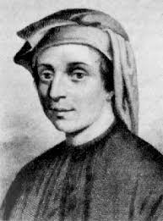
More Efficient Method to Calculate Fibonacci Numbers
Avoid repeated call to the fib method with the same arguments
The next Fibonacci number is calculated by adding the preceding two numbers in the sequence
If one stores the values of the preceding two numbers (not always calculating them), the algorithm is much more efficient

Slide 95
A Better Fibonacci Algorithm
#include <iostream>
using namespace std;
int fib(int n)
{
//Declare an array to store Fibonacci numbers
int f[n+1];
int i;
/* 0th and 1st number of the series are 0 and 1*/
f[0] = 0;
f[1] = 1;
for (i = 2; i <= n; i++)
{
/* Add the previous 2 numbers in the series
and store it */
f[i] = f[i-1] + f[i-2];
}
return f[n];
}
} See example fib2
The complexity of this new algorithm is O(n)
(tremendous improvement over the recursive algorithm)

Slide 96
Justification Techniques
Counterexample
Contrapositive
Contradiction
Induction

Slide 97

Generic Claim
To justify a generic claim, ones just needs to produce a particular example
For example: There is an element in x that has a particular property
One needs to produce such an element with that property

Slide 98
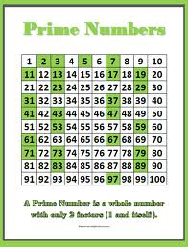
Counterexample
To justify a claim is false, one needs to produce a counterexample
For example: All integers of the form 2^{n} - 1 are prime
2⁴-1 = 15 is not prime

Slide 99
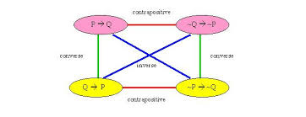
Contrapositives - (Use of Negatives)
To justify a statement “if p is true, then q is true” one can use the “negative”
“if q is not true, then p is not true”
Logically these two statements are equivalent but it is sometimes easier to work with the contrapositive

Slide 100

Contrapositives - (Use of Negatives)
if p is true, then q is true“ or if q is not true, then p is not true”
Example: Let a and b be integers. If ab is even, then a is even or b is even (if p is true then q is true)
Justification: consider the contrapostive: if a is odd and b is odd, the ab is odd (if q is not true then p is not true)
Let a=2n+1 and b=2m+1, then ab = 4nm + 2n + 2m+1 = 2(2nm+n+m) + 1 which is odd

Slide 101
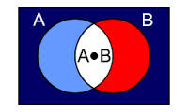
DeMorgan’s Law
Deals with negations
Not "(A and B)" is the same as "(not A) or (not B)”
(A ∩ B)' = A' U B‘
"not (A or B)" is the same as "(not A) and (not B)“
(A U B)' = (A' ∩ B')

Slide 102
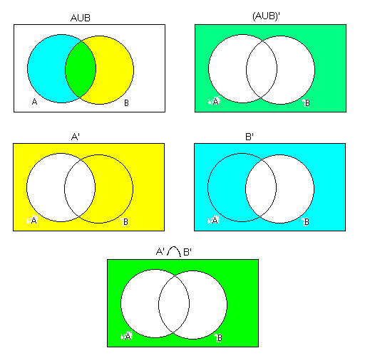
Proof of DeMorgan’s Law
Suppose that x ∈ (A U B)‘
Then x ∉ A U B which means that x ∉ A and x ∉ B. So x ∈ A' and x ∈ B' from which we conclude that x ∈ A' ∩ B‘
This shows that (A U B)' = (A' ∩ B')

Slide 103

Contradiction (DeMorgan’s law)
To show q is true, assume q is false and then show that this assumption leads to a contradiction
For example: Let a and b be integers. If ab is odd, then a is odd and b is odd
Assume ab is odd and a is even, then ab = (2n)b= 2nb which is even
This is a contradiction since ab cannot be odd and even simultaneously
This implies that a must be odd (similar logic can be used to show b must be odd)

Slide 104
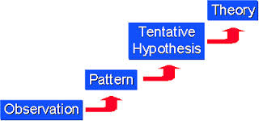
Induction
Induction
Used when making claims about an infinite set of numbers (n ≥ 1)
Cannot usually be done using direct methods

Slide 105

Induction Technique
We begin the induction by showing q(n) is true for n = 1 (and possibly other values n=2,3,…k) (base case)
Assume it is true for n’< n and show it is true for n

Slide 106
Example of Induction
Base case: Let n=1
n(n+1)/2 becomes 1=(1+1)/2 =1
Induction case
Assume it is true for n’< n and show it is true for n
For example:
Let n’ = n-1 and show the formula is true for n
Prove by induction that

Slide 107



Another Example of Induction
Claim: The Fibonacci function F(n) < 2^{n}
Justification by induction
Base cases
F(1) = 1 < 2 = 2¹
F(1) = 1 < 4 = 2²
Induction step
For n ≥ 2, suppose the claim is true for n’ < n
Since F(n) = F(n-1)+ F(n-2) and n-1 < n and n-2 < n, applying the induction assumption
Assume it is true of n-1 and n-2
Then F(n) = F(n-1)+F(n-2) < 2^{n-1}+2^{n-2} < 2^{n-1}+2^{n-1} = 2(2^{n-1}) = 2^{n}

